Slide 1
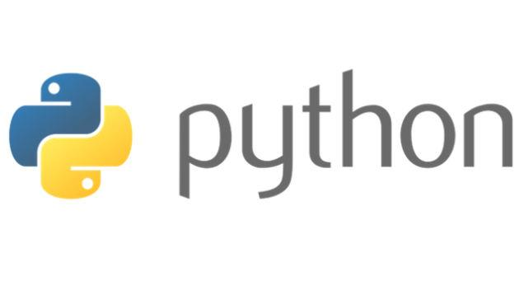
Variables, Keywords, Expressions, Statements
Notes:
1

Slide 2
Program
Sequence of instructions that specify how to perform a computation.
Basic instructions in almost every program:
Input: Get data from keyboard, or file or some other device.
Output: Display data on the screen or send data to a file or other device.
Math: Perform basic mathematical operations like addition and multiplication.
Conditional Execution: Check for certain conditions and execute the appropriate sequence of statements.
Repetition: Perform some action repeatedly , usually with some variation

Slide 3
Debugging
Programming errors are called bugs.
Process of tracking bugs and correct them is called debugging.
Types of Errors
Syntax Errors : invalid code the compiler doesn't understand
printf(%d,s)
Run Time Errors (Exceptions)
a= 10/0;
Semantic Errors : valid code the compiler understands
Dangling Else

Slide 4
Dangling Else
if (relative)
if (my friend)
cout << “both”;
else
cout << “neither”;
if (relative)
{
if (my friend)
cout << “both”;
}
else
cout << “neither”;

Slide 5
Formal and Natural Languages
Natural Languages are the languages that people speak, such as English, Spanish, French. They were not designed by people; they evolved naturally.
Formal Languages are languages that are designed by people for specific applications.
Programming languages are formal languages that have been designed to express computations.
Parsing is a process to figure out what the structure of the sentence is.
Notes:
So ,Guys how many of you are afraid of programming ???? , who think that coding is the most difficult thing to do ??? Pick one of them and ask him/her the recipe of Maggi or tea …
5

Slide 6
Difference between Natural and Formal Languages
Ambiguity: Natural languages are full of ambiguity.
Formal languages are designed to be nearly or completely unambiguous.
Redundancy: Natural languages are more redundant as compared to formal languages.
Literalness: Natural languages are full of idiom and metaphor. If I say, “The other shoe fell," there is probably no shoe and nothing falling. Formal languages mean exactly what they say.

Slide 7
Variable Expressions and Statements
Value is a one of the fundamental thing, that a program manipulates.
Variable is a name that refers to a value that maybe changed in the program.
The assignment statement creates new variables and gives them values:
>>> message = “Aman Kumar"
>>> n = 17
>>> pi = 3.1415

Slide 8
Keywords
Keywords define the language’s rules and structure and they can’t be used as variable names.
Python2 has twenty-nine keywords:
and def exec if not return assert del finally import or try
break elif for in pass while
class else from is print yield
continue except global lambda raise
Notes:
8

Slide 9
Keywords
These are reserved words with special meaning and purpose. They are used only for the intended purpose. Note : We cannot use a keyword as a variable name, function name or as any other identifier name.
Python 2 has 32 keywords while Python 3.5 has 33 keywords. An extra keyword called nonlocal was added in Python 3.5. 2 more keywords were added in Python 3.7 making it to 35
Latest version is also having 35 keywords
['False', 'None', 'True', 'and', 'as', 'assert', 'async', 'await', 'break', 'class', 'continue', 'def', 'del', 'elif', 'else', 'except', 'finally', 'for', 'from', 'global', 'if', 'import', 'in', 'is', 'lambda', 'nonlocal', 'not', 'or', 'pass', 'raise', 'return', 'try', 'while', 'with', 'yield’]

Slide 10
Python in its language defines an inbuilt module “keyword” which handles certain operations related to keywords. A function “iskeyword()” checks if a string is keyword or not. Returns true if a string is keyword, else returns false.
>>> import keyword
>>> keyword.iskeyword("true")
False

Slide 11
Which of the following options are correct?
1. Python version 3.5 has 33 keywords.
2. true is a valid keyword in Python.
3. The keyword nonlocal does not exist in Python 2.
4. Interpreter raises an error when you try to use keyword as a name of an entity.
5. A programmer can easily modify the keywords.
All options are correct
1,2,3 and 4 only
3 and 4 only
1,3 and 4 only

Slide 12
Which of the following options are correct?
1. Python version 3.5 has 33 keywords.
2. true is a valid keyword in Python.
3. The keyword nonlocal does not exist in Python 2.
4. Interpreter raises an error when you try to use keyword as a name of an entity.
5. A programmer can easily modify the keywords.
All options are correct
1,2,3 and 4 only
3 and 4 only
1,3 and 4 only

Slide 13
COMMENTS
A computer program is a collection of instructions or statements. A Python program is usually composed of multiple statements. Each statement is composed of one or a combination of the following:
Comments
Whitespace characters
Tokens
In a computer program, a comment is used to mark a section of code as non-executable.
Comments are mainly used for two purposes:
To mark a section of source code as non-executable, so that the Python interpreter ignores it.
To provide remarks or an explanation on the working of the given section of code in plain English, so that a fellow programmer can read the comments and understand the code.

Slide 14
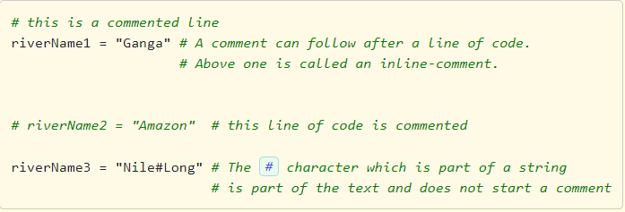
Types of Comments with examples
In Python, there are two types of comments:
Single-line comment : It starts with # (also known as the hash or pound character) and the content following # till the end of that line is a comment.
Docstring comment : Content enclosed between triple quotes, either ''' or """.
Below code example demonstrates the usage of comments:
Key points in relation to comments:
The # character must be specified at beginning of a comment line.
Comments do not nest. Meaning # has no special meaning inside a comment line which starts with #.
One cannot write comments inside string literals which are enclosed between single-quotes or double-quotes. The # character inside a string literal is treated as part of the string's content.
In a comment anything written after # in a particular line is ignored by the interpreter. Meaning it does not form part of the executable code in the program.

Slide 15
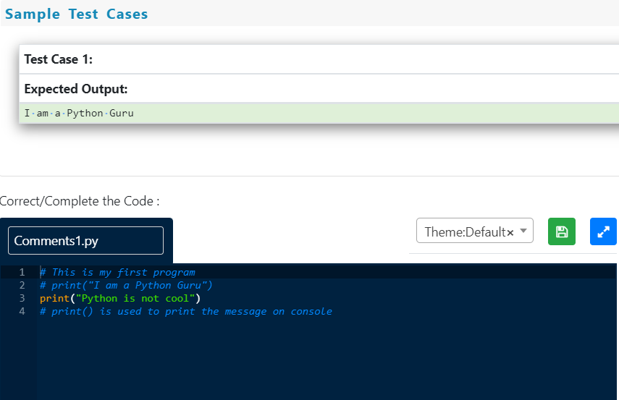
Practice Question:
Make the following changes in the below code :
Remove the comment on the line which prints "I am a Python Guru"
Add a comment on the line which prints "Python is not cool"

Slide 16
Python provides a way to specify documentation comments, called docstrings. A docstring is a string literal (plain text usually in English) provided in the source code to document what a particular segment of code does.
Python allows the use of both """triple-double-quotes""" or '''triple-single-quotes''' to create docstrings. However, the Python coding conventions specification recommends us to use """triple-double-quotes""" for consistency. The main purpose of docstrings in Python is to provide information on what a particular Python object does and not how it does According to the Python coding conventions, the docstring should always begin with a capital letter and end with a period (.)
Example:
""" This is a comment written in more than just one line """ print("Hello, World!")
Note: docstrings inside modules, classes, functions, members, method definitions, etc. will be done later

Slide 17
Identifier
An identifier is a name used to identify a variable, function, class, module, or object. In Python, an identifier is like a noun in English. Identifier helps in differentiating one entity from the other. For example, name and age which speak of two different aspects are called identifiers. Python is a case-sensitive programming language. Meaning, Age and age are two different identifiers in Python.
Rules:
1) Identifiers can be a combination of lowercase letters (a to z) or uppercase letters (A to Z) or digits (0 to 9) or an underscore ( _ ).
Examples:
myClass, var_1, print_this_to_screen, _number are valid Python identifiers.
2) An identifier can start with an alphabet or an underscore (_), but not with a digit.
Examples:
1_variable is invalid, but variable_1 is perfectly fine.
3) Keywords cannot be used as identifiers. (Keywords are reserved words in Python which have a special meaning).
Examples:
def, and, not, for, while, if, else etc.
4) Special symbols like !, @, #, $, % etc. are not allowed in identifiers. Only one special symbol underscore (_) is allowed.
Examples:
company#name, $name, email@id are invalid Python identifiers.
5) Identifiers can be of any length.

Slide 18
Which of the following options are correct?
1. Identifiers are used for identifying entities in a program.
2. We can use any special character like @,#,$ as part of identifiers.
3. 1st_string is a valid identifier.
4. string_1 is valid identifier.
5. Identifiers can be of any length.
All are Correct
1,2 and 3 only
1,4 and 5 only
1,3 and 4 only

Slide 19
Which of the following options are correct?
1. Identifiers are used for identifying entities in a program.
2. We can use any special character like @,#,$ as part of identifiers.
3. 1st_string is a valid identifier.
4. string_1 is valid identifier.
5. Identifiers can be of any length.
All are Correct
1,2 and 3 only
1,4 and 5 only
1,3 and 4 only

Slide 20
Statements
A statement is an instruction that the Python interpreter can execute.
When you type a statement on the command line, Python executes it and displays the result, if there is one.
A script usually contains a sequence of statements. If there is more than one statement, the results appear one at a time as the statements execute.
Notes:
20

Slide 21
Evaluating Expressions
An expression is a combination of values, variables, and operators.
If you type an expression on the command line, the interpreter evaluates it and displays the result:
>>> 1 + 1
2
A value all by itself is considered an expression, and so is a variable.
>>> 17
>>> x
17
Notes:
We all know YouTube as the place to upload cat videos and fails. As one of the most popular websites in existence, it provides us with endless hours of video entertainment. The Python programming language powers it and the features we love.
21

Slide 22
Simultaneous Assignments
Python also supports simultaneous assignments like this:
var1,var2…………..,varn=exp1,exp2…………….,expn
>>> a,b,c=4,5,6
>>> a
4
>>> b
5
>>> c
6

Slide 23
Write code to swap two numbers.
>>>X=1
>>>Y=3
>>>Temp=X
>>>X=Y
>>>Y=Temp
Can be written as:
>>>X=1
>>>Y=3
>>>X,Y=Y,X

Slide 24
What is the maximum possible value of an integer in Python ?
In Python, value of an integer is not restricted by the number of bits and can expand to the limit of the available memory.
>>> x=10000000000000000000000000000
>>> x
10000000000000000000000000000

Slide 25
As a side note, in Python 3, there is only one type “int” for all type of integers. In Python 2.7. there are two separate types “int” (which is 32 bit) and “long int” that is same as “int” of Python 3.x, i.e., can store arbitrarily large numbers.
x = 10
print(type(x))
x = 10000000000000000000000000000000000000000000
print(type(x))

Slide 26
Output in Python 2.7 :
<type 'int'>
<type 'long'>
Output in Python 3 :
<type 'int'>
<type 'int'>

Slide 27
Operators and Operands
Operators are special symbols that represent computations like addition and multiplication.
The values the operator uses are called operands
When both of the operands are integers, the result must also be an integer, and by convention, integer division always rounds down.
+, -, *, /, %, **,//
** is used for exponential.
/ is also used for float division
// is used to integer division
Notes:
DropBox started the online document storing revolution that has become part of daily life. We now store almost everything in the cloud. Dropbox allows us to store, sync, and share almost anything using the power of Python.
27

Slide 28
>>> 2/3
0.6666666666666666
>>> 2.0/3
0.6666666666666666
>>> 2.0/3.0
0.6666666666666666

Slide 29
>>> 2//3
0
>>> 2.0//3
0.0
>>> 2.0//3.0
0.0
>>> 2.0//10
0.0
>>> 2.0//10.0
0.0

Slide 30
Order of Operations
When more than one operator appears in an expression, the order of evaluation depends on the rules of precedence.
Parentheses have the highest precedence and can be used to force an expression to evaluate in the order you want.
Exponentiation has the next highest precedence.
Multiplication ,Float Division, Integer Division and remainder have the same precedence, which is higher than Addition and Subtraction, which also have the same precedence.
Operators with the same precedence are evaluated from left to right.
Notes:
Survey Monkey is the largest online survey company. They can handle over one million responses every day on their rewritten Python.
30

Slide 31
Operations on Strings
Mathematical operations can’t be performed on strings, even if the strings look like numbers.
the + operator represents concatenation.
For Example:
fruit = "banana"
bakedGood = " nut bread“
print(fruit + bakedGood)
The * operator also works on strings; it performs repetition.
For eg:
"Fun"*3 is "FunFunFun"
Notes:
Python also provides the power behind the most popular search engine in the world – Google. The programming language can handle the traffic and computing needs of the search engine and its connected apps.
31

Slide 32
Composition
One of the most useful features of programming languages is their ability to take small building blocks and compose them
Comments
It is a good idea to add notes to your programs to explain in natural language what the program is doing. These notes are called comments.
they are marked with the # symbol:
For eg:
# compute the percentage of the hour that has elapsed
percentage = (minute * 100) / 60
Notes:
Quora is the number one place online to ask a question and receive answers from a community of individuals. On their Python website relevant results are answered, edited, and organized by these community members.
32

Slide 33
Questions ??

Slide 34
Programs
1 There are 5280 feet in a mile. Write a Python statement that calculates and prints the number of feet in 13 miles
2 Write a Python statement that calculates and prints the number of seconds in 7 hours, 21 minutes and 37 seconds.
3 The perimeter of a rectangle is 2w+2h, where w and h are the lengths of its sides. Write a Python statement that calculates and prints the length in inches of the perimeter of a rectangle with sides of length 4 and 7 inches.

Slide 35
Programs
The circumference of a circle is 2πr where r is the radius of the circle. Write a Python statement that calculates and prints the circumference in inches of a circle whose radius is 8 inches. Assume that the constant π=3.14.

Slide 36
Programs
Given p dollars, the future value of this money when compounded yearly at a rate of r percent interest for y years is p(1+0.01r)y. Write a Python statement that calculates and prints the value of 1000 dollars compounded at 7 percent interest for 10 years.
Write a Python expression that combines the string "Joe Warren is 52 years old." from the string "Joe Warren" and the number 52 and then prints the result (Hint: Use the function str to convert the number into a string.)

Slide 37
Programs
Write a single Python statement that combines the three strings "My name is", "Joe" and "Warren" (plus a couple of other small strings) into one larger string "My name is Joe Warren." and prints the result.
The distance between two points (x0,y0) and (x1,y1) is (x0−x1)²+(y0−y1)². Write a Python statement that calculates and prints the distance between the points (2,2) and (5,6).

